Slide 1

Application of Model-based Method and Artificial Intelligence in Mechanical Ventilation Treatment
SPEAKER
Ir. Dr. CHIEW YEONG SHIONG
School of Engineering, Monash University Malaysia
13 November 2024
Medical Engineering and Technology Hub

Slide 2
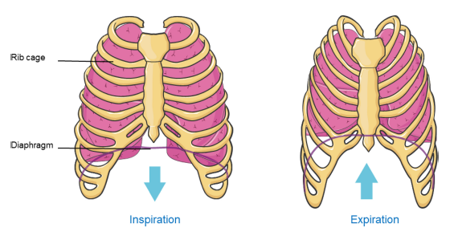
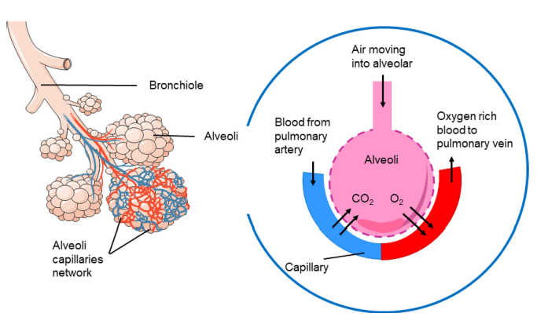
Introduction
PRIMARY FUNCTION OF THE HUMAN LUNG
Ventilation and Perfusion (in other words… breath)
Ventilation: Transport of surrounding air into the lung
Perfusion: Gas exchange in the alveoli and alveoli capillaries
WHAT IF HUMAN LUNG FUNCTION IS IMPAIRED?
Essentially, the patient is not able to breath properly and/ or not getting enough oxygen
Pneumonia, sepsis, trauma, near drowning etc
Acute respiratory failure

Slide 3
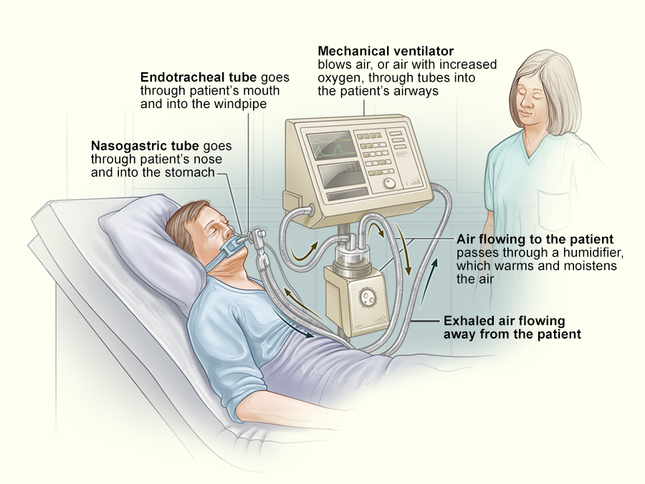
Introduction
Acute Respiratory Failure - 1.3 to 34 per 100,000 person
Patients are given mechanical ventilation treatment
Mechanical ventilator (MV) is a device that delivers oxygen to the patient using positive pressure
Pressure
Tidal Volume
Respiratory Rate
Fraction of Inspiration Oxygen (FiO2)
Positive End Expiratory Pressure (PEEP)
Mode of Ventilation
Fully Controlled (Volume Control, Pressure Control)
Partially Controlled (Pressure Support, NAVA)

Slide 4
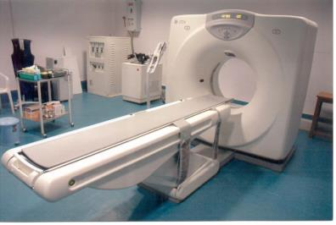
Problems
“Humans are horribly variable”
(Pretty et al., 2012, Dickson et al., 2014)
Disease and response is patient-specific
The generalise approached (One size fit all)
Clinicians rely on intuitions and experience to set MV
no non-invasive assessment method
To make things worst, suboptimal mechanical ventilation treatment risks further lung injury
Mortality up to 30~60%
Cost of MV Euro 600, per patient, per day

Slide 5
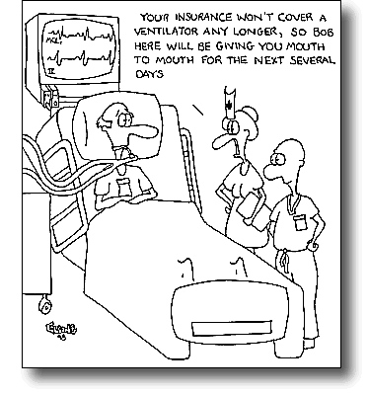

Research Need
A need of a non-invasive method to individualise MV treatment
Model-based and AI in Mechanical Ventilation
Capture patient-specific condition and response to MV setting
Develop metric to aid clinical decision making
Improve the quality of care
Setting MV in a consistent and objective way
Reduce the length of MV

Slide 6
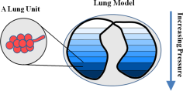
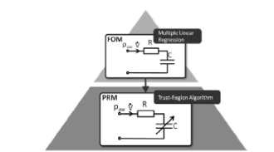
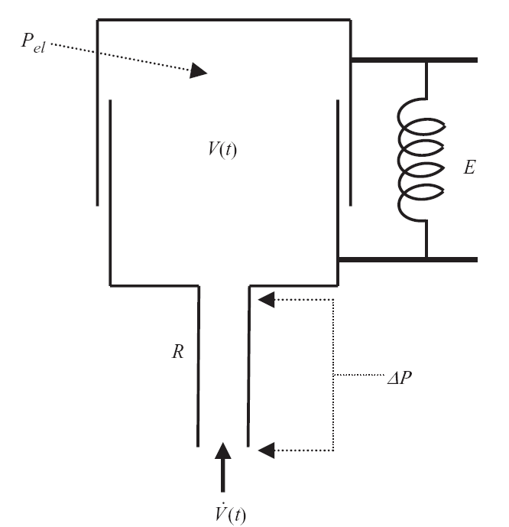
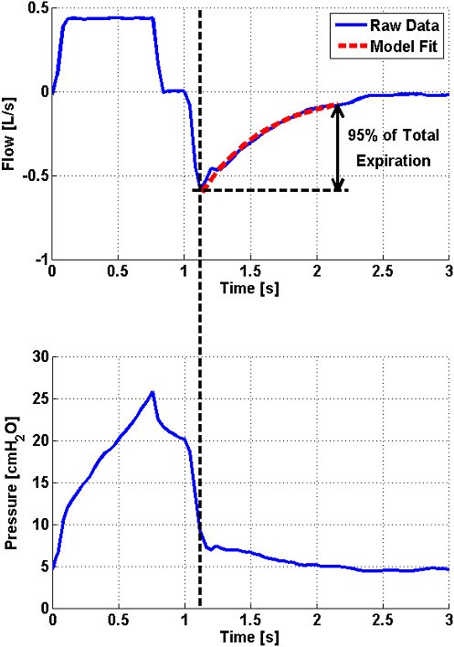
Model-based AND AI assisted MV
Minimal recruitment model (Sundaresan et al., 2009)
Pressure recruitment model (Schranz et al., 2011)
Dynamic elastance model (Chiew et al., 2011)
Perfusion model (Morgensen et al., 2011)
Ventilation model (Steimle et al., 2011)
Time-varying elastance model (van Drunen et al., 2013)
Virtual patient model (Morton et al., 2019, Cong et al., 2020)
Stochastic model (Lee et al. 2021, Ang et al. 2022 )
AI detection model (Loo et al, 2021, Chong et al. 2021)

Slide 7
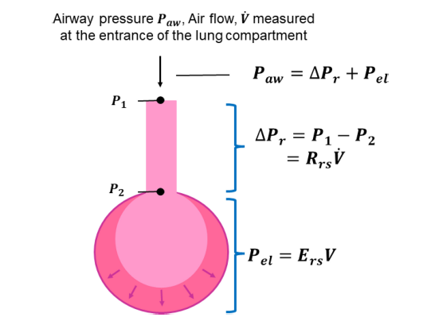
1. Model–based Digital patient
Development of patient digital twin Testing potential treatment in virtual patients prior to applying to actual patient
Single compartment linear lung model
P_{aw}(t) = R_{rs}*Q(t) + E_{rs}*V(t) + P_{o}
P_{aw} - Airway pressure
t - Time
R_{rs} - Airway resistance
Q - Air flow
E_{rs} - Respiratory System Elastance
V - Lung volume
P₀ - Offset pressure
Monitors the respiratory system elastance and resistance

Slide 8
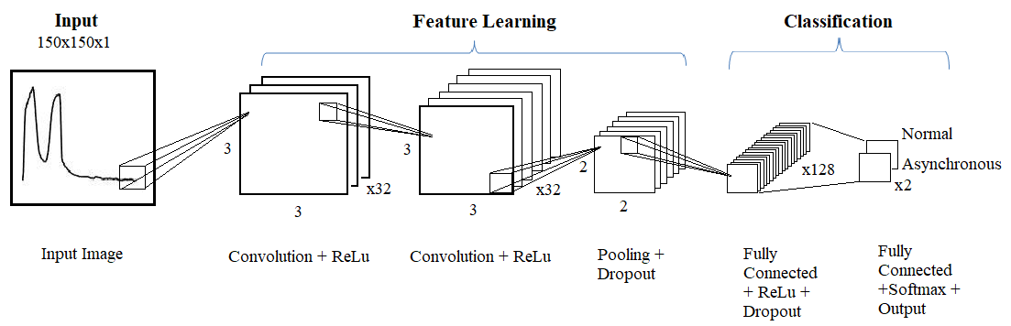
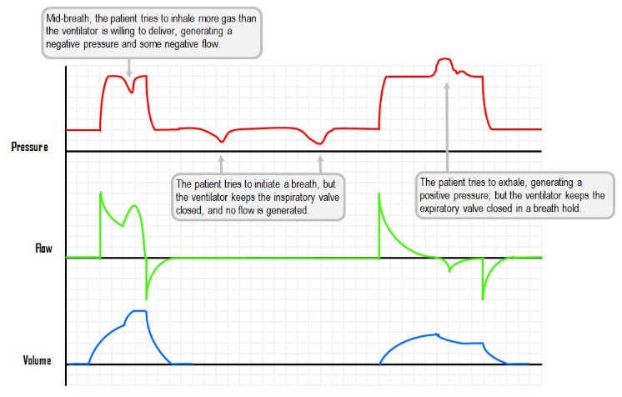
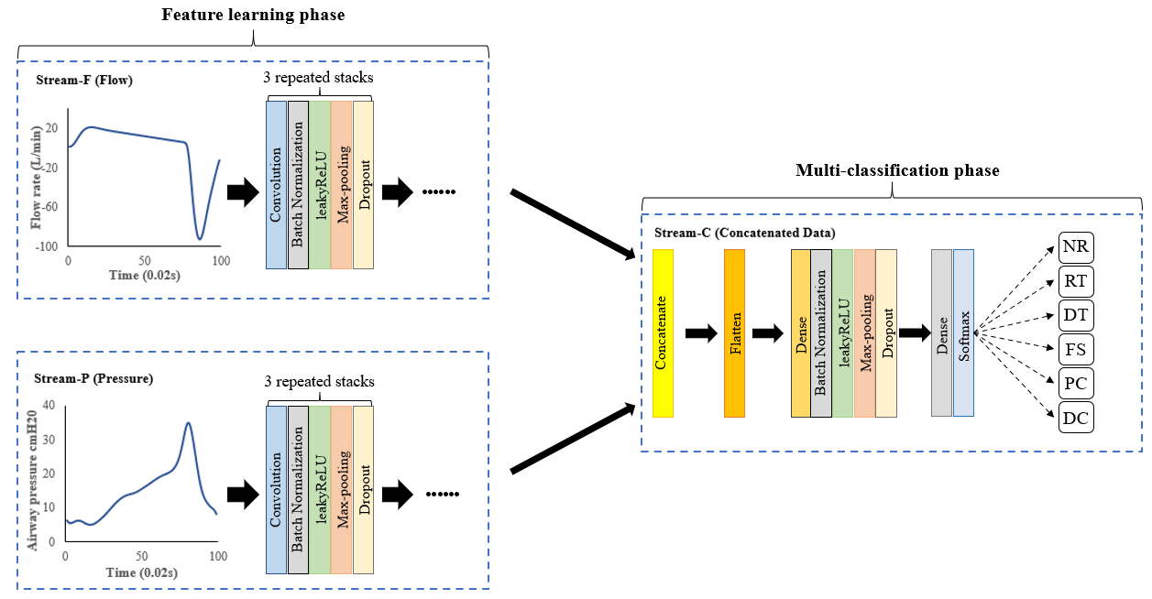
2. Artificial intelligence FOR DIAGNOSTICS
Using AI to identify asynchrony
Identify asynchrony breaths using MV data
AI training and classification

Slide 9




Clinicians
Mechanical Ventilator
Respiratory Failure Patient
Clinician sets ventilator settings
Ventilator applies the selected settings to patient
Software
Airway pressure and flow data are transferred to the computing platform
Patient’s breathing is monitored and controlled by the ventilator
Software calculates the best MV setting and recommends to clinician

Slide 10
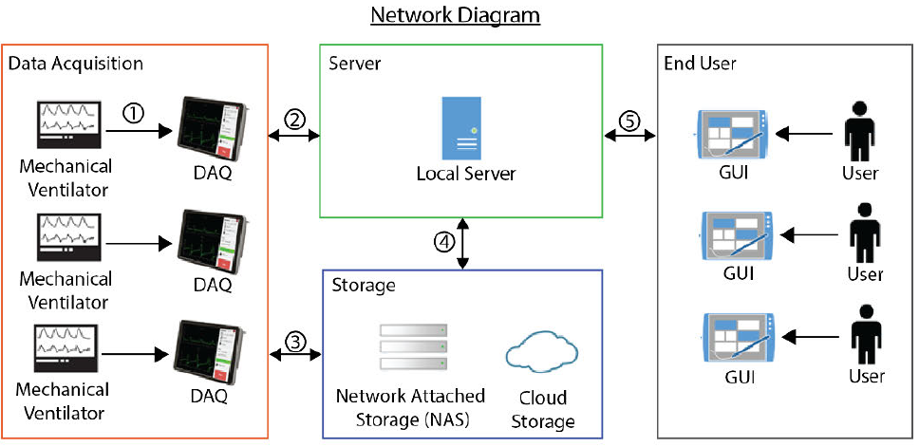
3. Development of Patient monitoring system
carenet
Connect to each ventilator in the ICU ward
Data is transferred to local server
Backup in cloud storage
Data in server and cloud are synchronised
Interface for monitoring and analysis

Slide 11
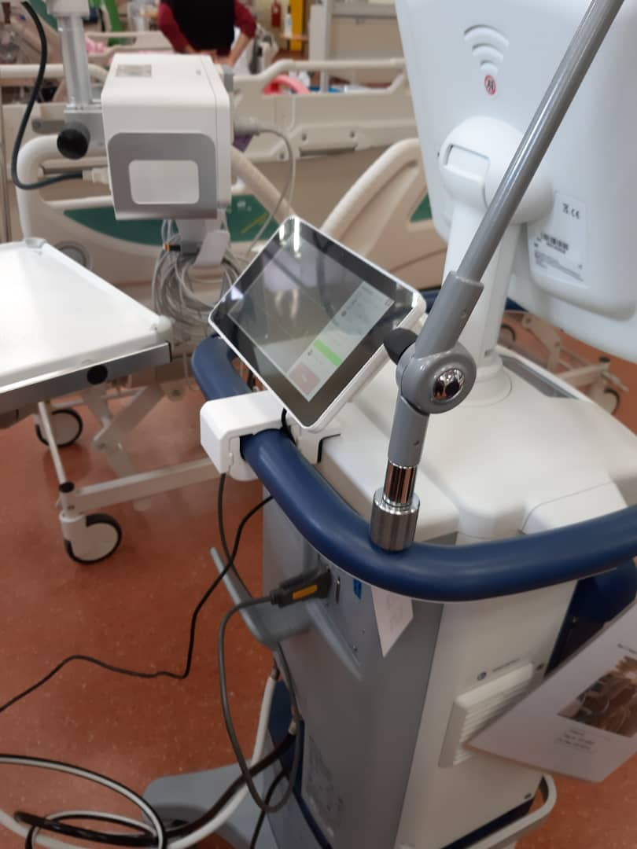
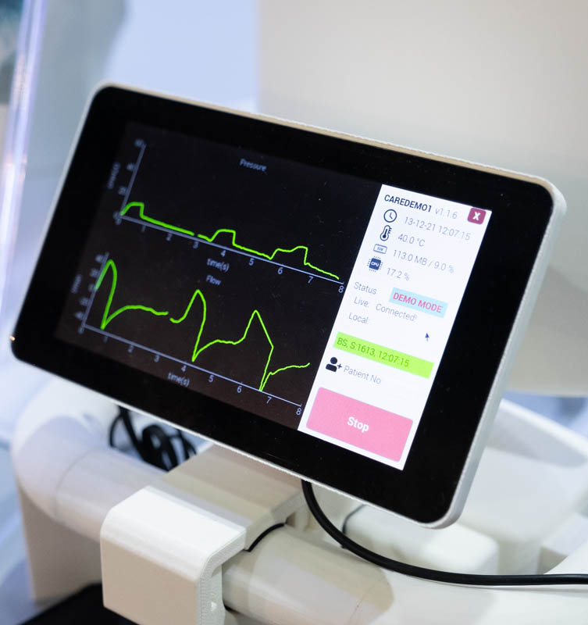
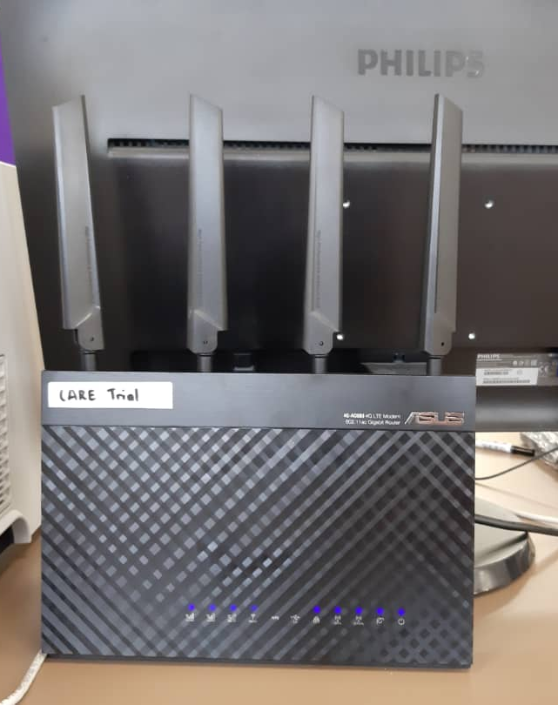
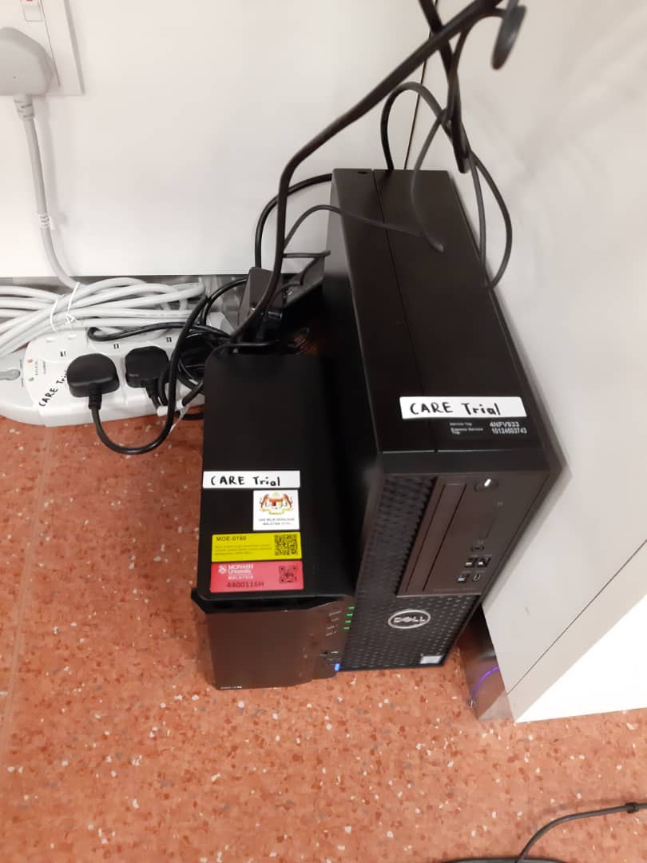
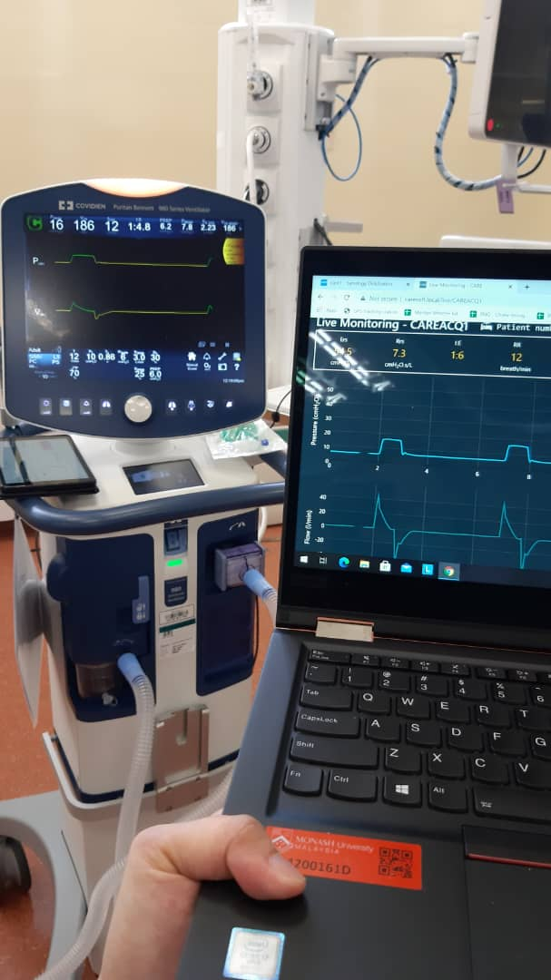
3. Development of Patient monitoring system
1. Develop data acquisition system to continuously monitor patient remotely
Help in data collection
Conduct and support clinical trials

Slide 12
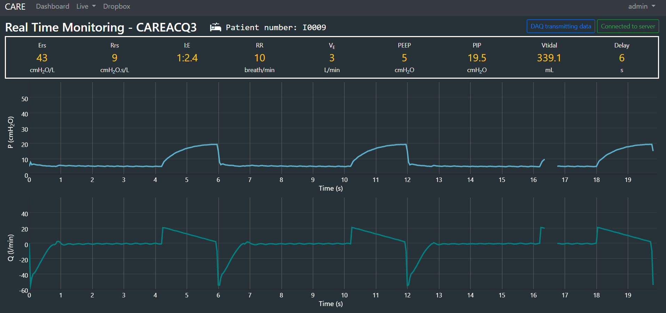
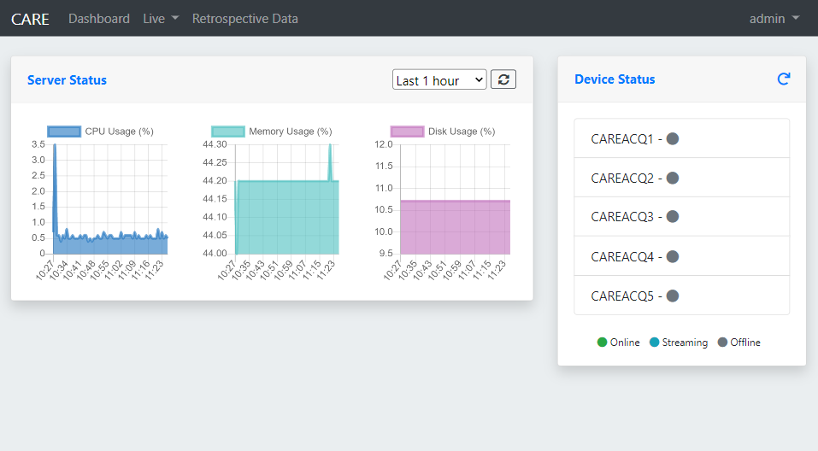
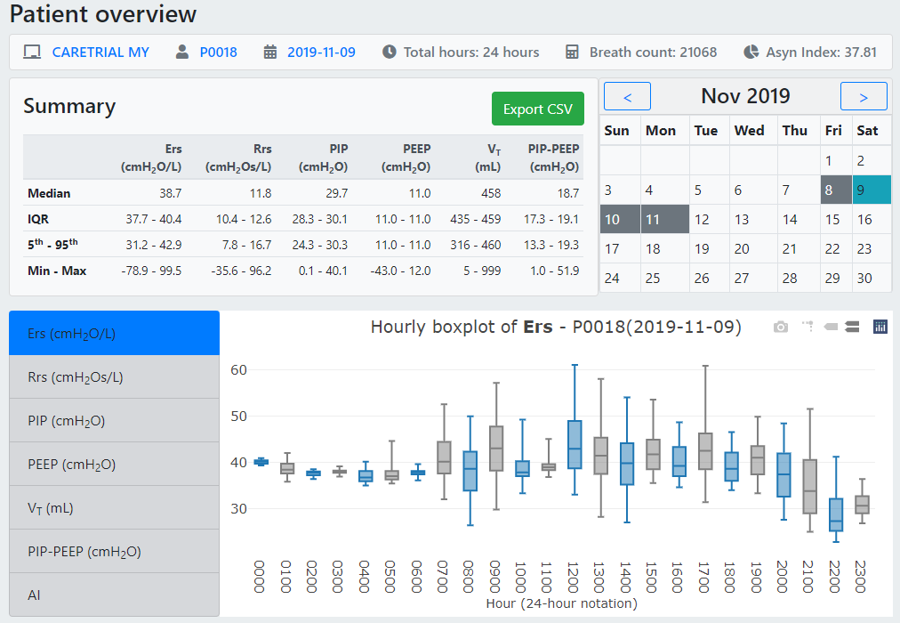
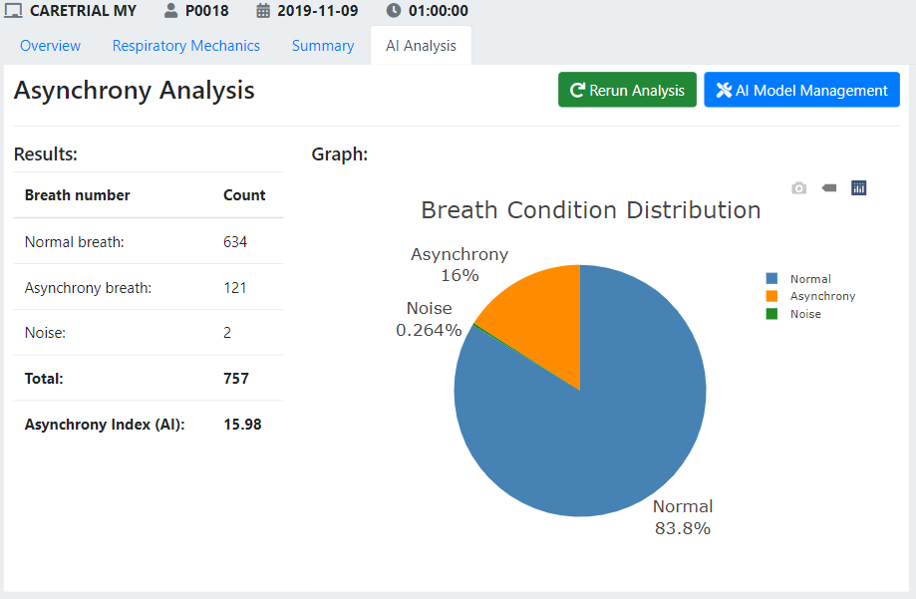
2. Software development for real time analytics of MV patient data

Slide 13
4. ONLINE RESOURCES
1. Setting mechanical ventilator: Resource from Hamilton
https://e-academy.hamilton-medical.com/auth/RepositoryEntry/47841280/CourseNode/99319570534703
2. Data acquisition system construction manual
https://www.sciencedirect.com/science/article/pii/S2468067222001031
3. Mechanical Lung construction manual
https://www.sciencedirect.com/science/article/pii/S2468067224000737

Slide 14

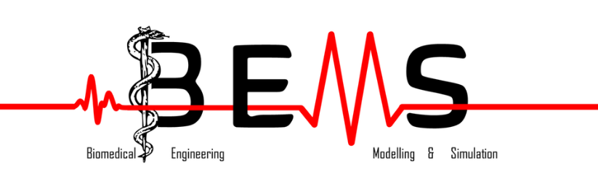
THANK YOU
FIND OUT MORE AT MONASH.EDU.MY
CHIEW.YEONG.SHIONG@MONAHS.EDU

